Slide 1

Knowledge Quiz Time – What are the Key words
Archers are the most useful of Saxon Peasant. Skilled in the use of the bow they can help defend your castle by shooting your enemies from far away .Although they are not very skilled in hand to hand combat.
Saxon peasants don’t make the greatest soldiers, but fortunately they don’t cost very much and they definitely cost less than hiring a Norman man-at-arms. He’s okay using an axe or a spear, but he can do alright in a desperate situation.
A professional Norman soldier skilled with good armour able to use both a sword to deal with enemies and a crossbow and a sword. But they are expensive to train and you need to pay them.
A tall tower made from thick stone making it very difficult for enemies to attack the walls of your castle. It also has a fighting area on top where your archers can shoot from or a ‘mangonel’ can be mounted.
These small holes within the castle and tower walls allow your archers to shoot out in almost complete safety.
A large siege weapon that can throw a large rock a long distance to take out enemies from far away and can even take out enemy weapons that can threaten your defences.
These are small holes on the inside of your Gateway. If any attackers get through then your soldiers can throw rocks and even boiling water down these holes onto the attackers.
Pitch is an oil like liquid that after being heated can be poured on any attacking soldiers. Boiling pitch is particularly nasty as it sticks to the enemies skin as it burns! It can also be poured down murder holes.
moat is a large ditch that surrounds the castle, often filled with water to make approaching the castle even more difficult. But digging such a big ditch means you have to hire a lot of men.

Slide 2
Trained Archer:Archers are the most useful of Saxon Peasant. Skilled in the use of the bow they can help defend your castle by shooting your enemies from far away .Although they are not very skilled in hand to hand combat.
Peasant SoldierSaxon peasants don’t make the greatest soldiers, but fortunately they don’t cost very much and they definitely cost less than hiring a Norman man-at-arms. He’s okay using an axe or a spear, but he can do alright in a desperate situation.
Man at Arms A professional Norman soldier skilled with good armour able to use both a sword to deal with enemies and a crossbow and a sword. But they are expensive to train and you need to pay them.
Stone Tower A tall tower made from thick stone making it very difficult for enemies to attack the walls of your castle. It also has a fighting area on top where your archers can shoot from or a ‘mangonel’ can be mounted.
Arrow Slits These small holes within the castle and tower walls allow your archers to shoot out in almost complete safety.
Mangonel A large siege weapon that can throw a large rock a long distance to take out enemies from far away and can even take out enemy weapons that can threaten your defences.
Murder Hole These are small holes on the inside of your Gateway. If any attackers get through then your soldiers can throw rocks and even boiling water down these holes onto the attackers.
Boiling Pitch Pitch is an oil like liquid that after being heated can be poured on any attacking soldiers. Boiling pitch is particularly nasty as it sticks to the enemies skin as it burns! It can also be poured down murder holes.
The moat - moat is a large ditch that surrounds the castle, often filled with water to make approaching the castle even more difficult. But digging such a big ditch means you have to hire a lot of men.

Slide 3

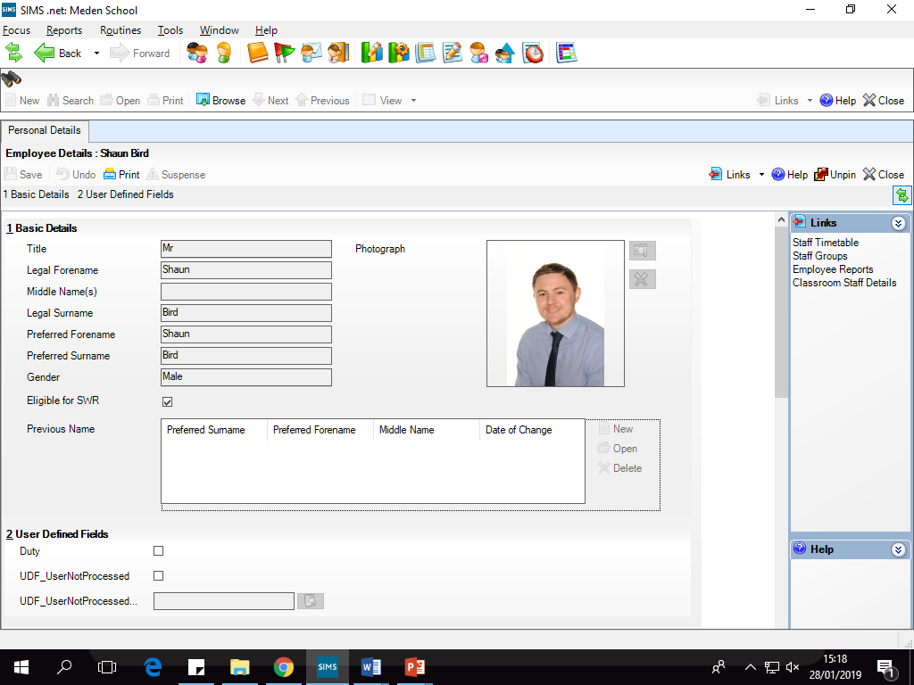

I want to take over Mr Bird’s Classroom. What items/people would I need to launch a successful attack?

Slide 4
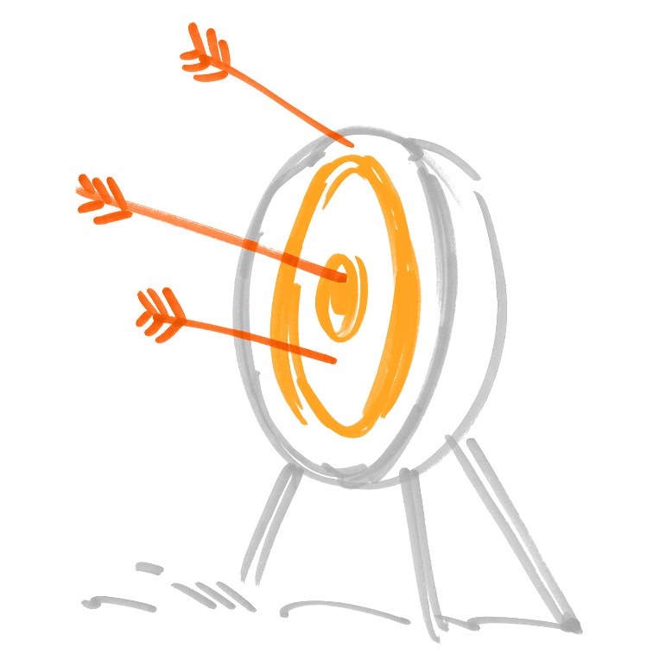
Aims
To know the techniques that were used for attacking a castle.
To be able to write a quality description of an attack.
To be able to analyse the reliability of a film clip.

Slide 5
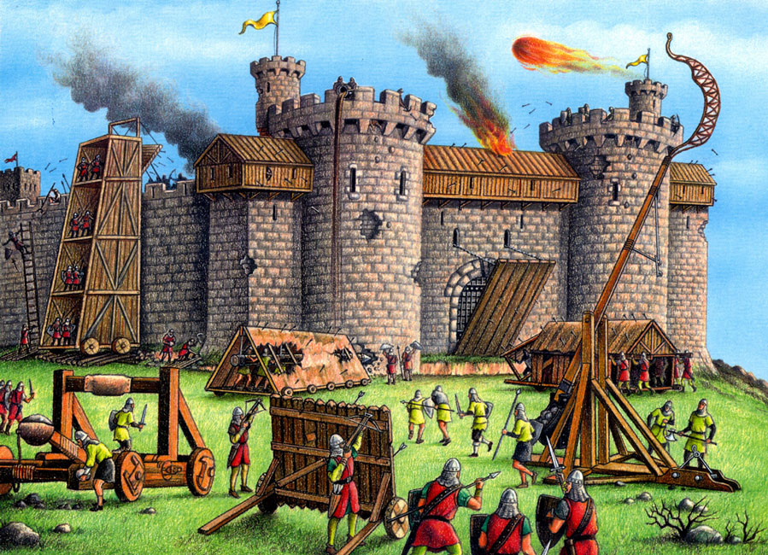
What can we learn about attacking castles from this picture?

Slide 6
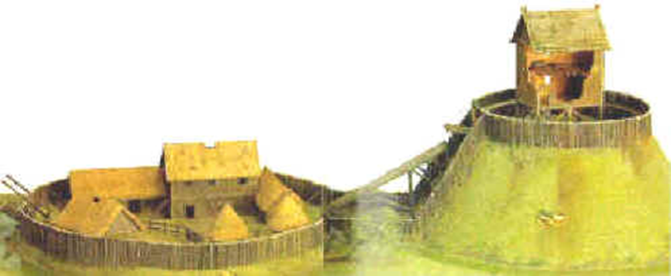
Lets Go Attacker Shopping…………..
You have had enough of paying taxes, working on the land and being insulted by Normans. You decide to attack the castle. You will have to answer was it difficult to take over castles in the Medieval times?
You will plan your attack to destroy the Norman castle and drive them out of England.
You have a budget that you can use to buy weapons.
You cannot go over the budget - if you do then you instantly fail.
You will then be using the weapons that you bought to plan your attack.
You will also need to give a reason for buying the goods.

Slide 7
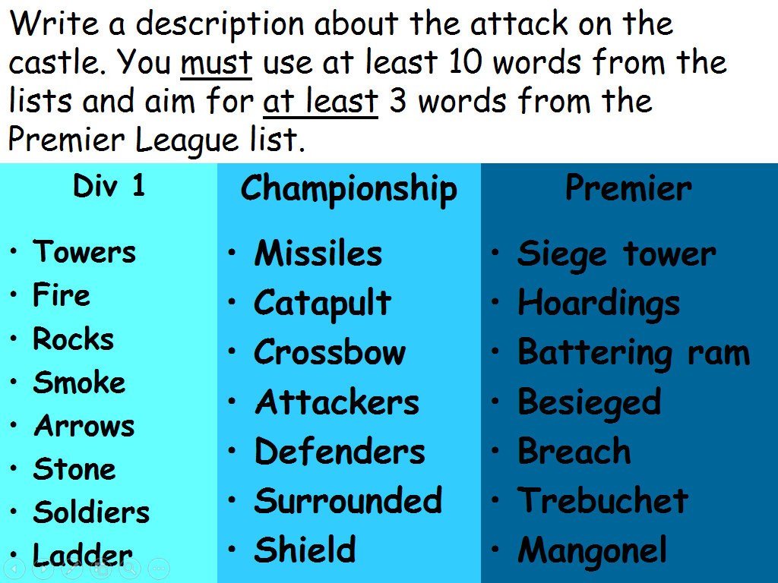
Premier
Siege Tower
Food Hoardings
Battering Ram
Breach
Mangonel
Ballista
Man At arms

Slide 8
Plenary
Sketch a triangle in the back of your book and complete the sections based on todays learning.
I didn’t
know…………
# about
the lesson
Tester Question
Key
Word
Key
Word
Key
Word

