Slide 1
Sex Hormones
LO’s: 1. Puberty is triggered by the release of hormones. 2. Changes happen in the male and female body during puberty.
Puberty starts when sex hormones are released during your teen years.
The sex hormone that triggers puberty in men is called testosterone (tes-tos-ter-one).
The sex hormone that triggers puberty in females is called Oestrogen (oes-tro-gen).
Key words: puberty, sex hormones, testosterone and oestrogen.
Notes:
5 mins. Play with words here. Write on whiteboards etc.

Slide 2
Questions (Whiteboards):
LO’s: 1. Puberty is triggered by the release of hormones. 2. Changes happen in the male and female body during puberty.
Q1. What is the name of the male hormone? (30s)
Q2. What is the name of the female hormone? (30s)
Q3. Where do you think testosterone will be made in the male reproductive system? (1 min)
Q4. Where do you think oestrogen will be made in the female reproductive system? (1 min)
Testosterone
Oestrogen
The testes.
The ovaries.
Key words: puberty, sex hormones, testosterone and oestrogen.
Notes:
Focus on spellings.
30s
1 min

Slide 3

Changes at Puberty | Boys | Girls
The breasts grow larger
The shoulders grow broader
The hips grow broader
Hair grows under the arms
The body becomes more muscular
The monthly periods start
Voice breaks and becomes deeper
Hair grows around the sex organs
Hair and skin become more greasy
Sperm are produced
Ova (eggs) are produced
Feel attracted to opposite sex
GPA your answers.
Notes:
5 mins

Slide 4
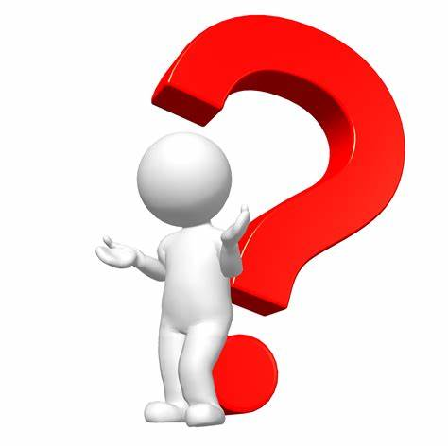
Question
LO’s: 1. Puberty is triggered by the release of hormones. 2. Changes happen in the male and female body during puberty.
The male sex hormone is called:
Oestrogen.
Progesterone.
Testosterone.
Key words: puberty, sex hormones, testosterone and oestrogen.

Slide 5
Question
LO’s: 1. Puberty is triggered by the release of hormones. 2. Changes happen in the male and female body during puberty.
The female sex hormone is called:
Oestrogen.
Progesterone.
Testosterone.
Key words: puberty, sex hormones, testosterone and oestrogen.

