Slide 1
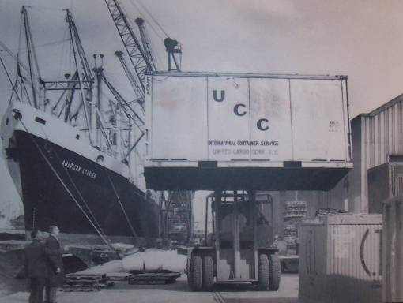
Has regeneration in London been successful?
Know what gentrification/regeneration is.
Explain why gentrification/gentrification is needed.
Evaluate the impacts of gentrification/regeneration on society.

Slide 2
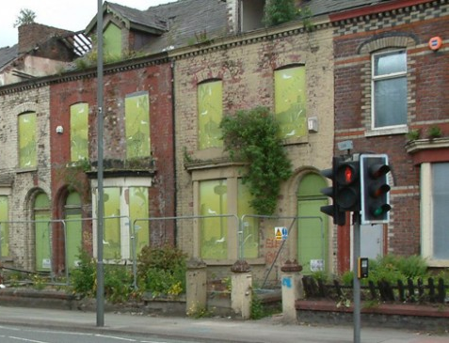
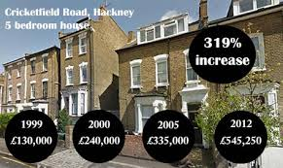
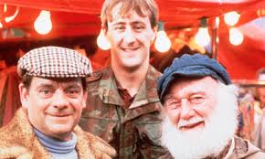
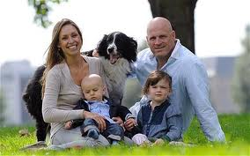
Use the images to define, in your own words, what regeneration/gentrification is.
Write your ideas on a post it note, then swap your post it
Working class out
Middle class in

Slide 3
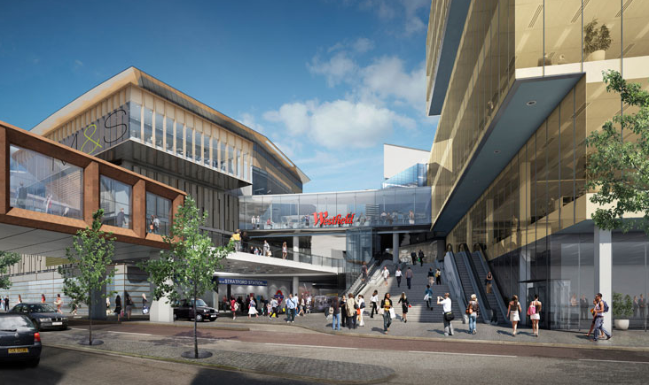
The geographers definition:
Know what gentrification is
Explain why gentrification is needed
Evaluate the impacts of gentrification on society
Check to see how your definition matches up with the technical definition.
Gentrification is the changing of older poorer quality areas into more modern and expensive areas.

Slide 4

Know what gentrification is
Explain why gentrification is needed
Evaluate the impacts of gentrification on society
I am not sure what gentrification is
I can tell you what is involved in gentrification
I can tell you what is involved in gentrification and give and example of where it has happened

Slide 5
Use the images to help come up with a definition for regeneration/gentrification
Can you remember the definition?
Write your ideas on a post it note, then swap your post it
Working class out
Middle class in

