Slide 2
Where the ‘impact’ happens
Teacher
Autonomy
Great Meden Teaching
Educational Research

Slide 3
Agreeing that the ‘active ingredients’ of teaching with impact are…
Practice
Feedback
Questioning
Learning Principles
Modelling
Explanation
Challenge

Slide 4

Where am I now?
Test Zone
New Potential

Slide 5


Teacher Self-improvement
Improve NOT Prove
How effective am I right now?
Self evaluation
Student progress info
Trusted feedback
QA feedback
What do I intend to do to improve?
What might it look like to be more effective?
Knowledge of self
Time
Priorities: Personal & Professional
Goals
Motivation
Support
?
Research evidence: CPD & reading
Teaching & Curriculum
Professional role-models
Assessment Knowledge
Teacher rounds
What possible ways could I improve personally?
Teacher Now
Future Improved Teacher
Self evaluation
Trusted feedback
QA feedback
Teacher rounds

Slide 6


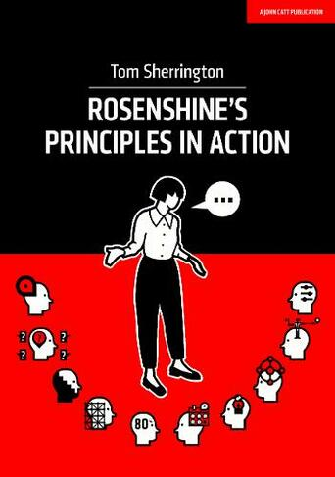



Department Teaching and Learning Communities Process
HOD will email out agenda
&
Staff to bring a printout of their T&L Profile to DTLC
Review
Review actions and outcomes of QA/teacher rounds from the last DTLC.
Pre-Meeting
Discussion
Spotlight
1 week before the DTLC a pre-meeting task will be emailed out to all teaching staff.
This task will take no more than 10 minutes and will involve reading an extract from Rosenshine's Principles in Action Book or a blog post. This will be discussed at the start of each DTLC.
Staff discuss their thoughts about the pre-meeting task. Do they agree or disagree with it? How would it impact on teaching and learning at Meden?
HOD/Team member focuses on the work they have done which is based on the departmental/individual profile from the T&L portal and informally presents it to the departmental team.
Actions
The departmental team agrees actions and CPD to work on from now until the next DTLC. DTLC meeting action notes to be circulated by HOD 24hrs after the meeting.
Improve NOT Prove

Slide 7
Teacher Rounds
Teacher Rounds occurs in the classroom, in real-time.
it is about learning in and from practice. It is not a process of evaluation. No judgments are made – ever!
involves everybody in the Rounds group (department) taking a turn to be the host teacher.
involves the Round teacher identifying the ‘learning principle’ for the Round observation.
involves a discussion in the DTLC about the progress from last meeting and what lessons the member of staff wants the rest of the team to come and observe.
is a collaborative process. It’s a way to bring extra eyes and ears to the task of learning what students are thinking and doing and what is engaging them and to what the resulting impact is.
involves a minimum of three and up to seven teachers. This ensures that a range of experiences and multiple perspectives are brought to the process.
entails intentional reflection, observation, inquiry and collaboration. Every member of the Round group are reflective partners and take-away something from the lesson

Slide 8
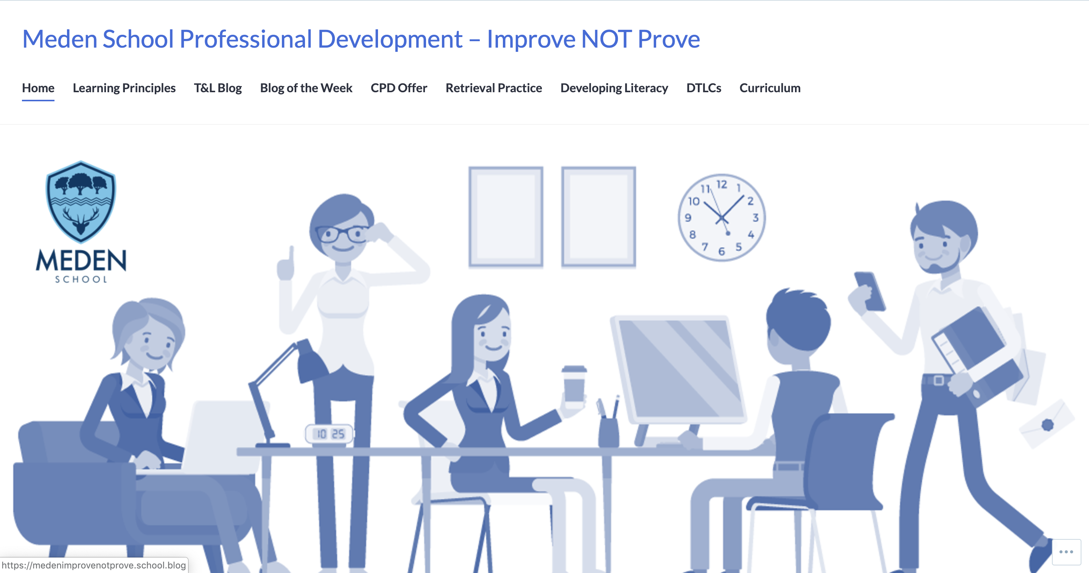

Slide 9
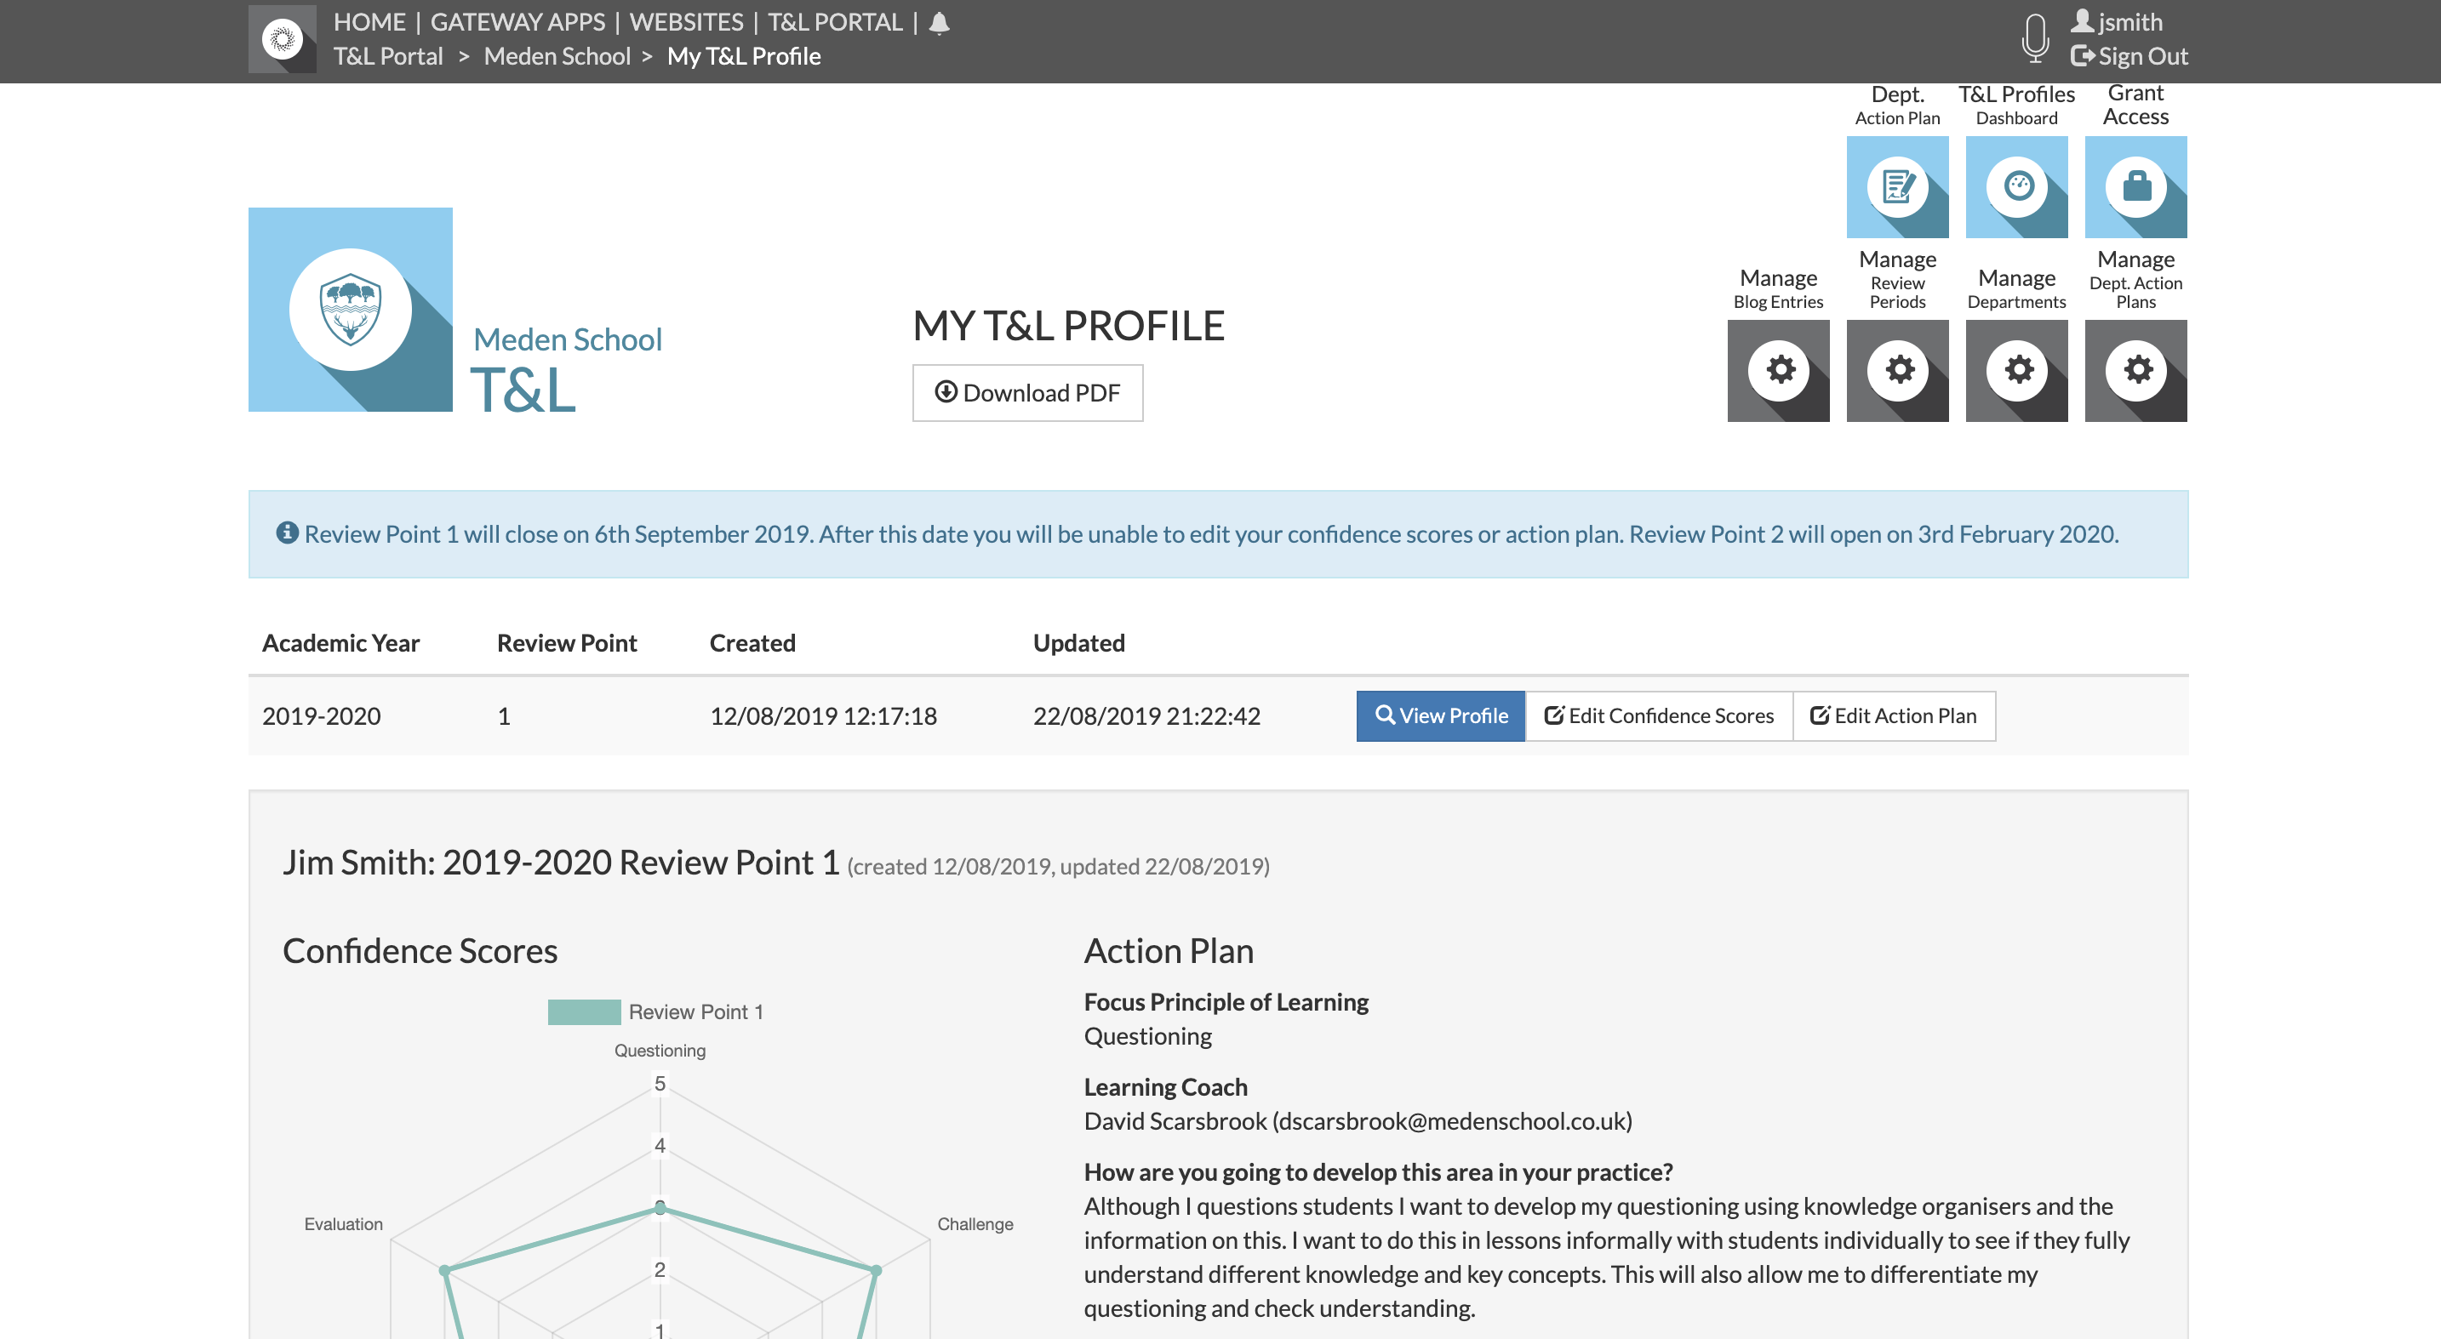
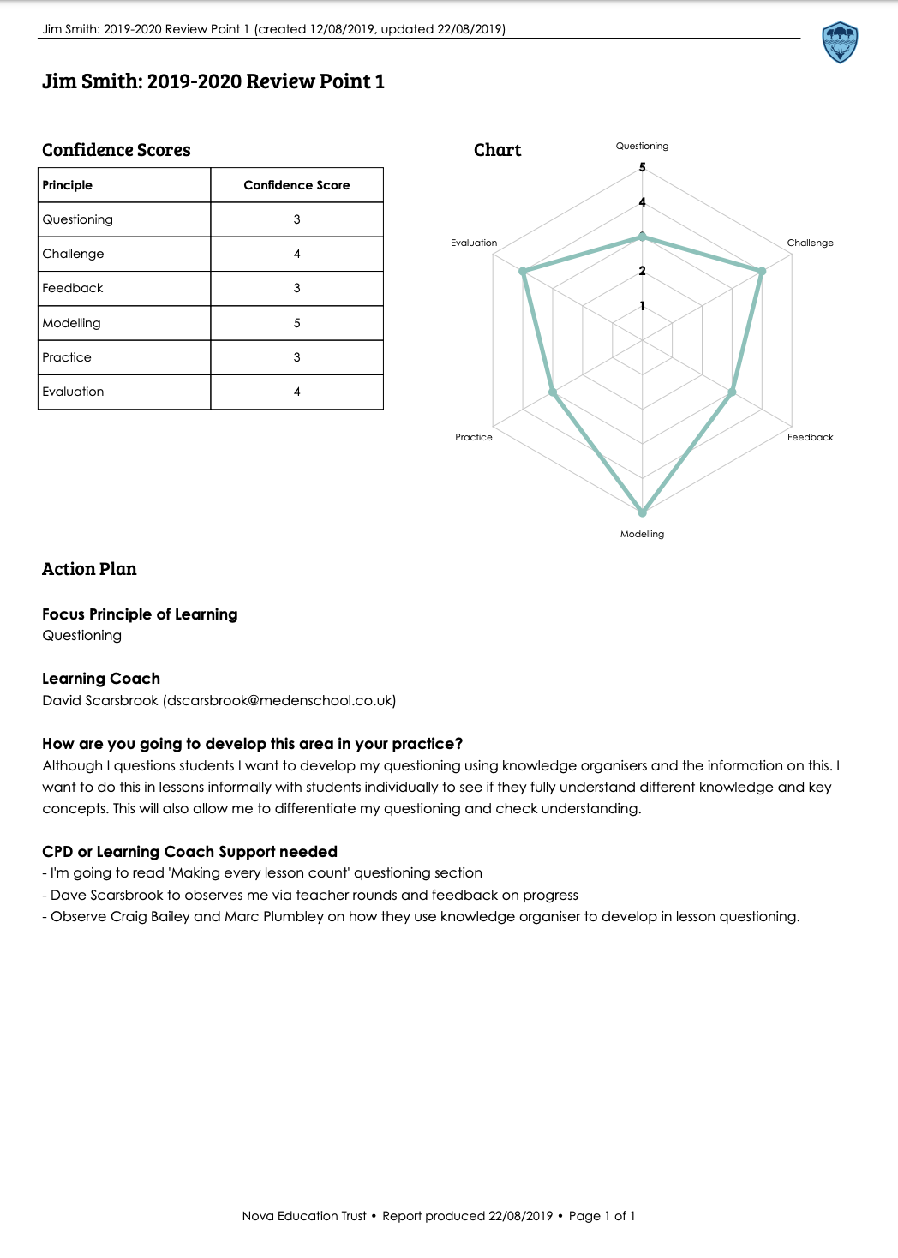

Slide 10
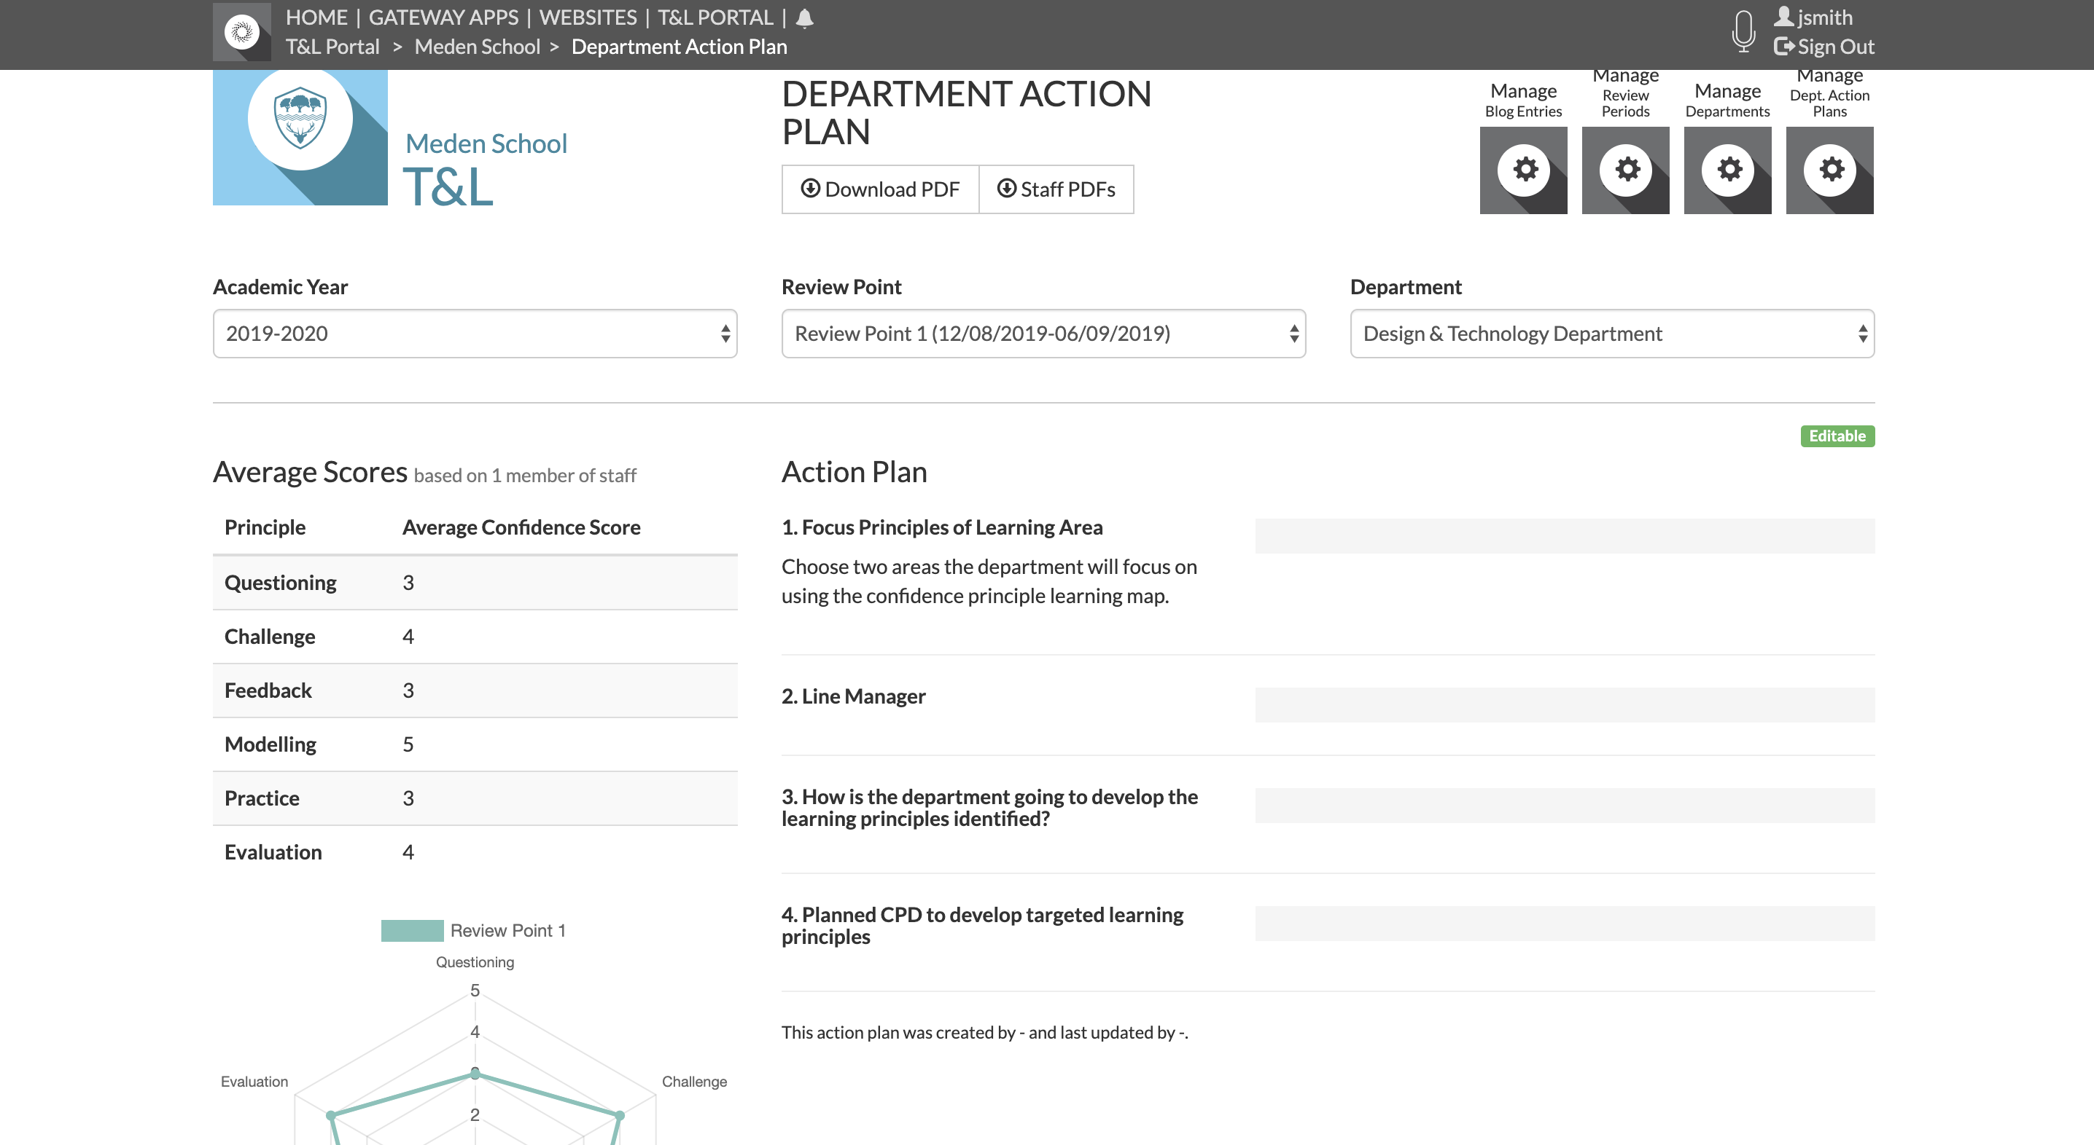

Slide 12
Meden’s Focus Groups
Boys
High Ability
Disadvantaged
How does the learning principle(s) you/department are going to develop over the next year support the achievement and learning of Meden’s focus groups?
In your action plans link them to Meden’s focus groups

Slide 13
Having
IMPACT

Slide 14
What Next?
Remember the focus groups when filling in your individual T&L profile and the department action plan
Individual T&L profile – by the end of the week
Download T&L profile as a PDF an save it
Department Action Plan – by the end of the week
T&L Pack

